Slide 1
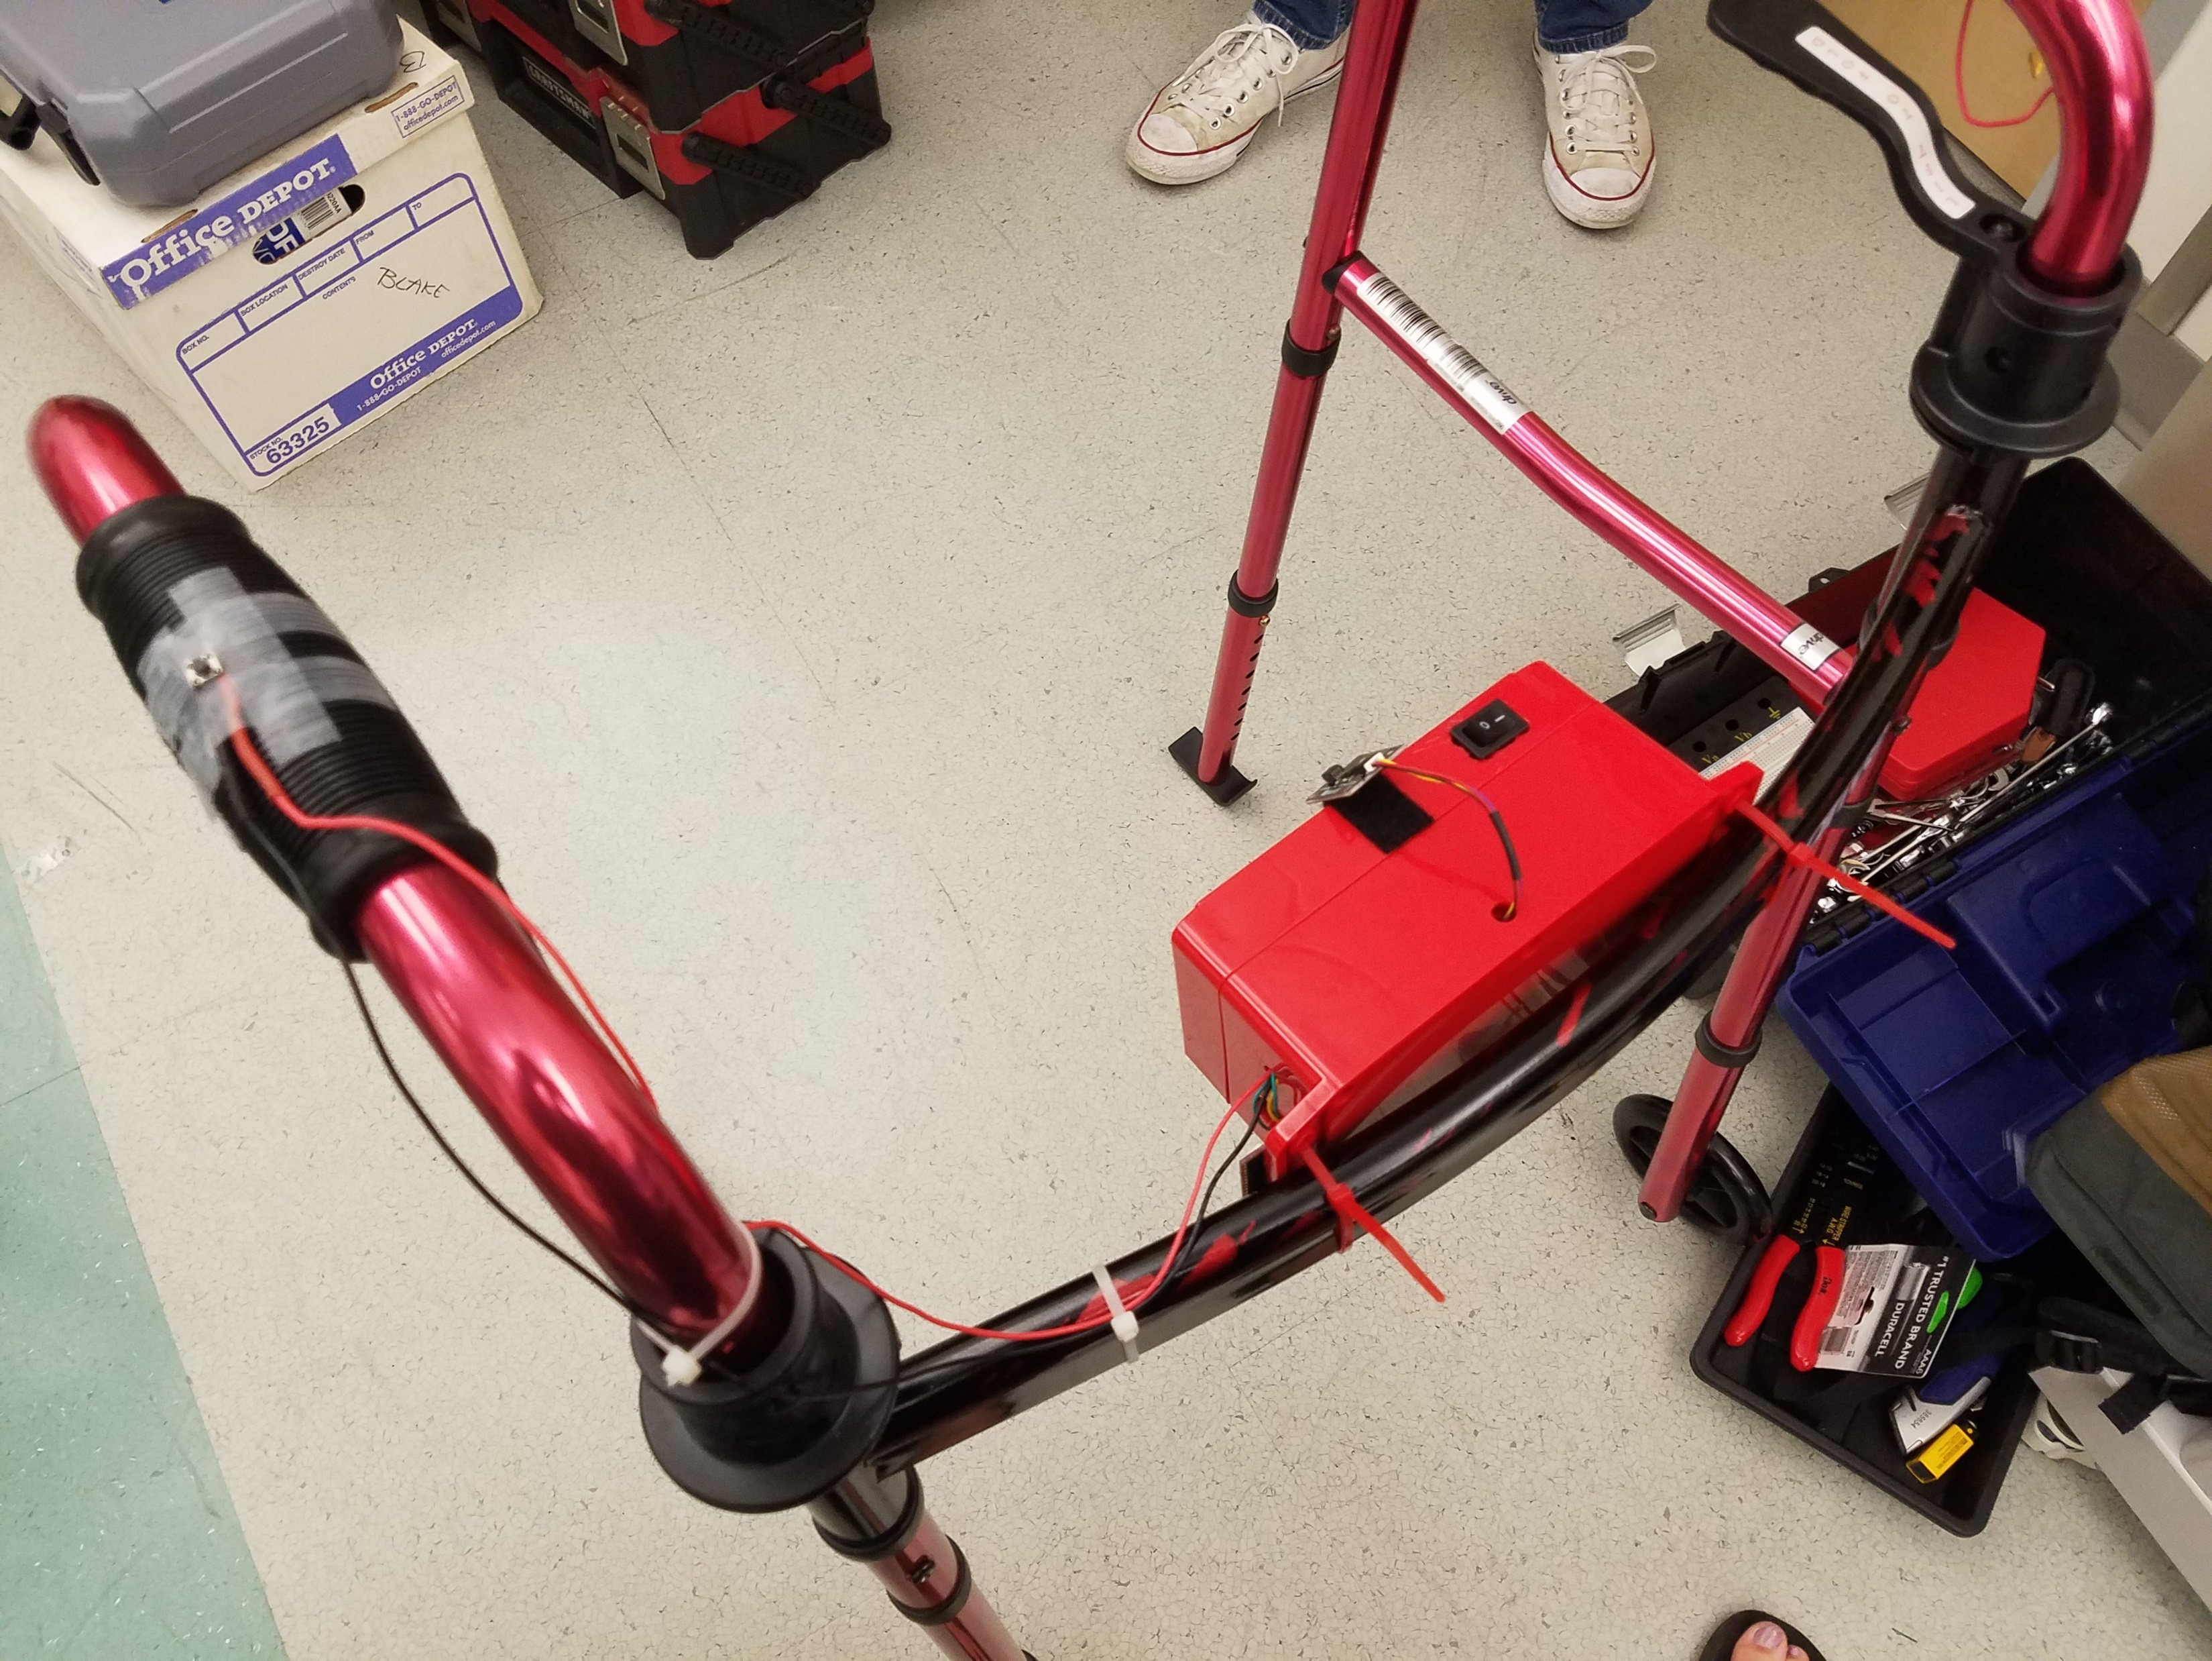
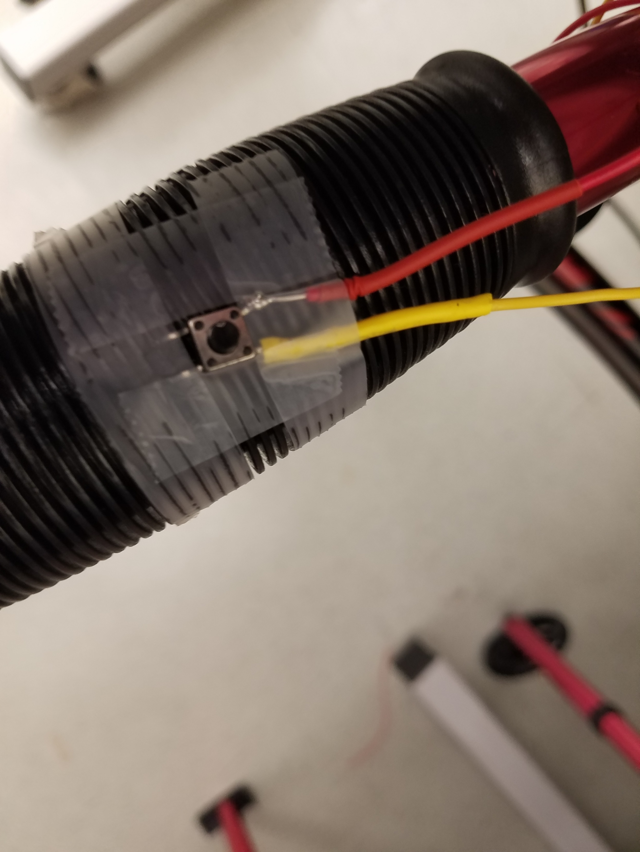
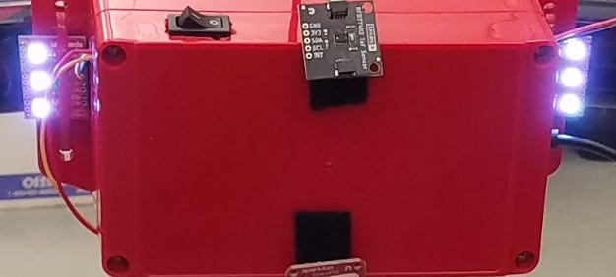
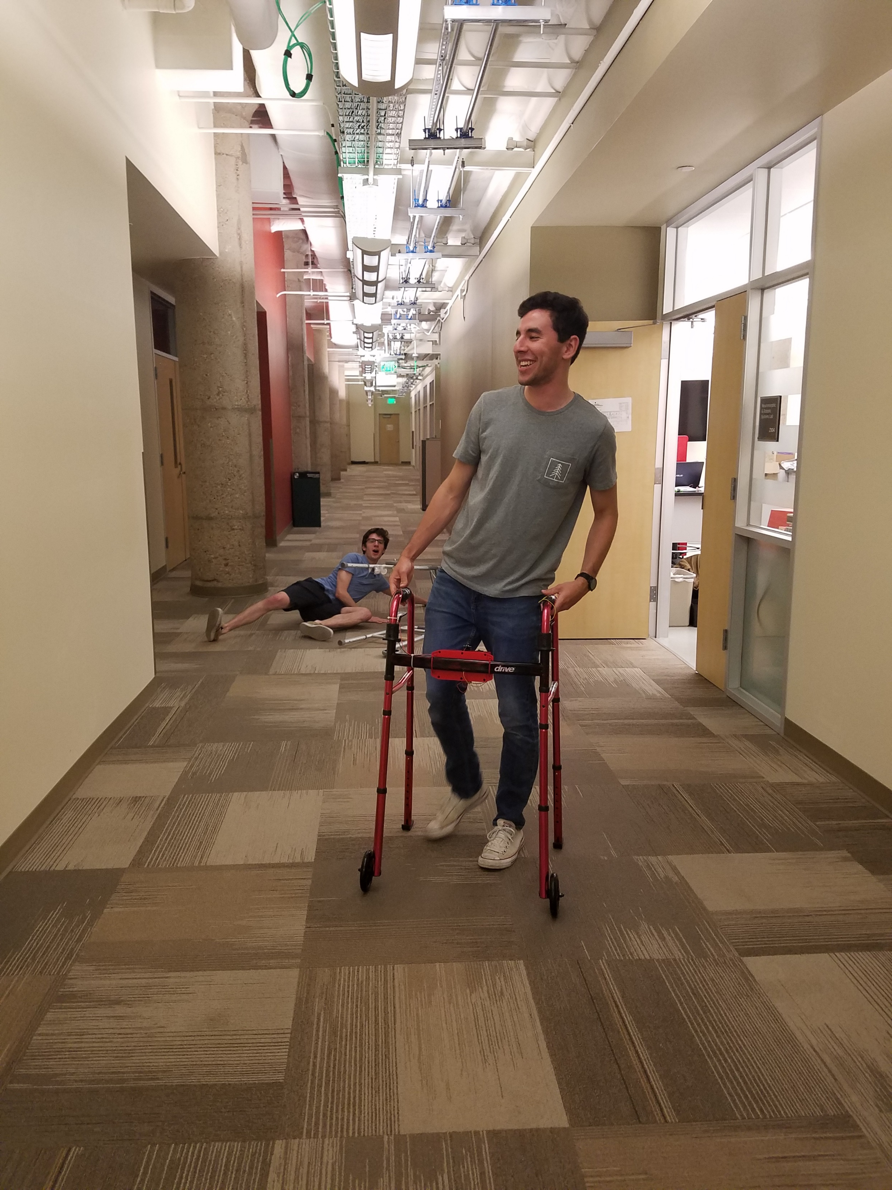
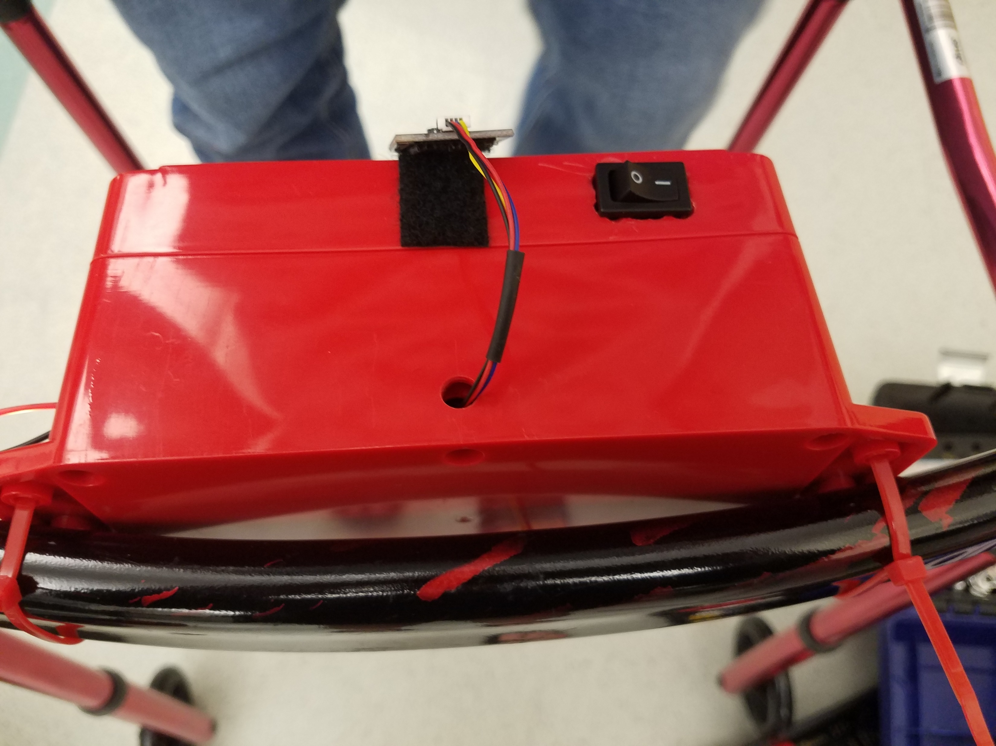
Live alone, but need a walking aid? You should try…
The Smartwalker!
Walker fitted with sensors, buttons, and lights to check in on your presence and make you safe!
Gives reminders to use through help of lights!
WOW your friends!
Logs time of use daily!
All stored in a lightweight box!

